Slide 1
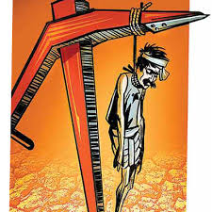
Farmer Suicides
By
Dr. V. S. Karpe
Dept. of Economics
Sarvajanik Arts & Commerce College, Visarwadi, Tal. Navapur, Dist. Nandurbar

Slide 2
Importance Of Agricultural
Share in national income
Employment
Providing of food
Contribution to capital formation
Providing row material
International trade
Providing of fodders

Slide 3
Farmer Suicides in India
Year | Numbers of Farmer Suicides
1995 | 10720
1996 | 13729
1997 | 13622
1998 | 16015
1999 | 16082
2000 | 16603
2001 | 16415
2002 | 17971
2003 | 17164
2004 | 18241
2005 | 17131
2006 | 17060
2007 | 16632
2008 | 16196
2009 | 17368
2010 | 15964
2011 | 14027
2012 | 13754
2013 | 11772
2014 | 12360
Total | 308826

Slide 4
In last 20 years, more than 300000 farmers have ended their lives.
On an average 38 farmers commit suicide every day in India, one Indian farmer commits suicide 32 minutes between 1197 and 2005 and since 2012, this has become one suicide every 30 minutes.
Almost 75 per cent of farmer suicide have occurred amongst the Small and Medium farmer.

Slide 5
All India Worst-affected States in 2014
(in Percentage)

Slide 6
One farmer commits suicide 53 minutes in the state of Maharashtra, Andhra Pradesh, Karnataka, Madhya Pradesh and Kerala.
Maharashtra state with 60,000 farmers suicides which is 27.5 per cent of total farmer suicide.
Nearly half of all suicides of farmers in 2014 were in Maharashtra alone with Telangana.

Slide 7
Reasons for Farmer Suicide
Indebtedness
Increase cost of agriculture inputs
Reduce price of agricultural production
Withdrawal of Government support
Repeated crop loss
Drought
Monsoons
Lack of Proper Irrigation
Ground water
Crop failure
Green Revolution
Girl Child

Slide 8
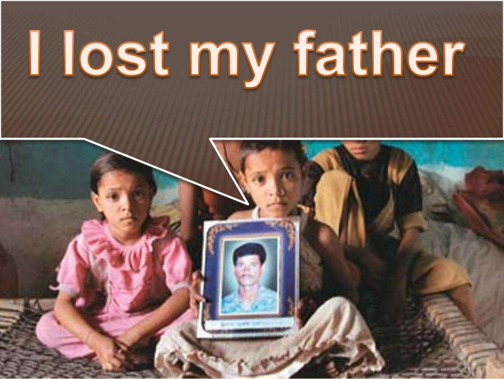
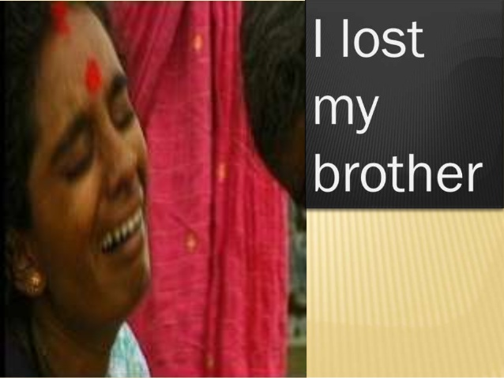


Slide 9
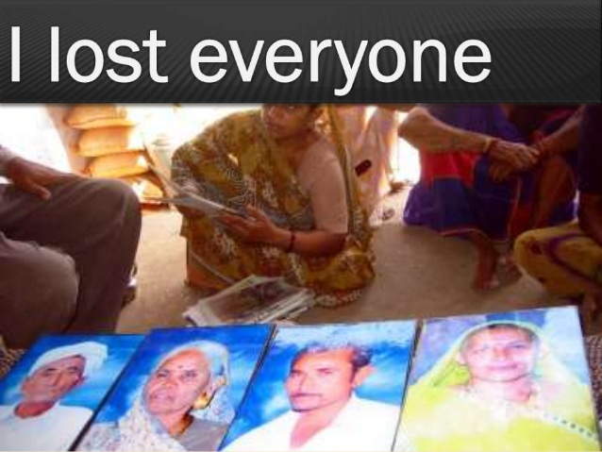
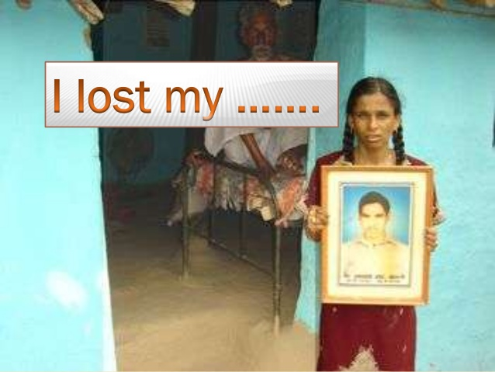

Slide 10
You got everything
What did you loose

Slide 11
Thank You …..

